Slide 1
Registration Instructions HCR 3.0
Hockey Canada Registry (HCR) 3.0
WMHA July 1, 2021

Slide 2
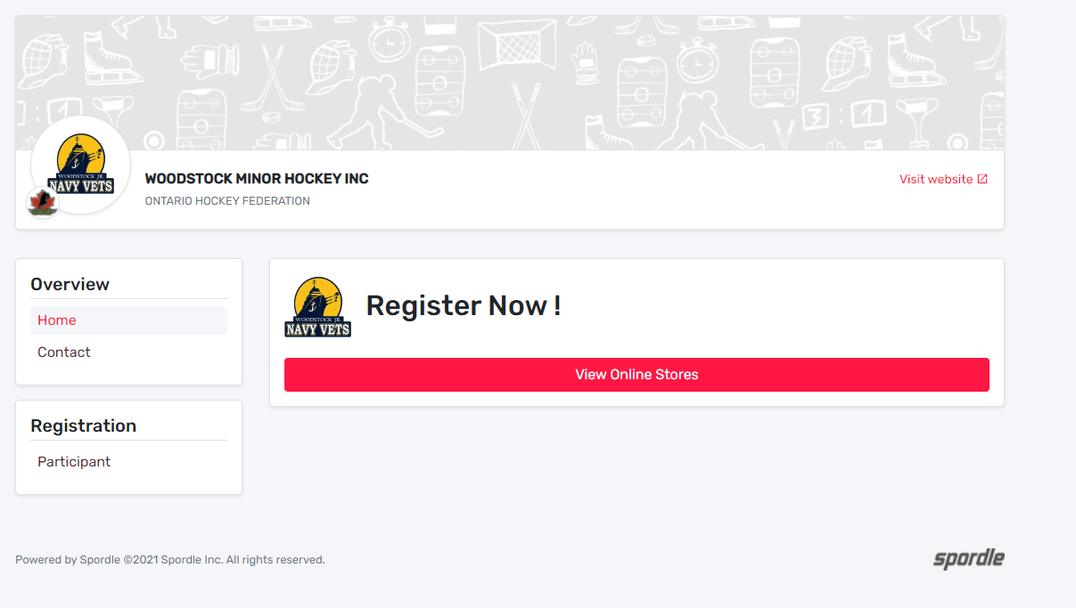
General
Hockey Canada has rolled out a new registration platform for both the Association and the end user. It has been a large project across Canada and may associations have participated in the pilot project.
The following slides are provided to help you through the registration process.
You should find that the new release is much easier to use and repetition is severely cut down on address entry, etc.
WMHA July 1, 2021

Slide 3
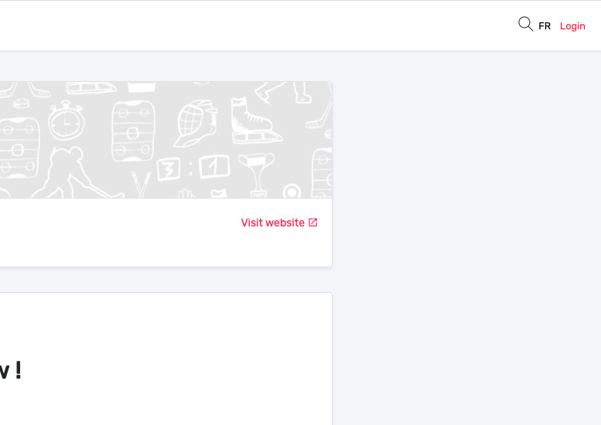
First Sign-in
When you first click the link from our WMHA Website, you will be taken to the “Register Now!” page. In the upper right corner, you will see the “Login” button. You will click there to create your account in HCR 3.0.
NOTE: All members/participants have been migrated from the old system and you can use any email you have in the past or a new email going forward. i.e. Even though you may be in the system from the migration, new accounts are set up due to newer security settings.
WMHA July 1, 2021

Slide 4
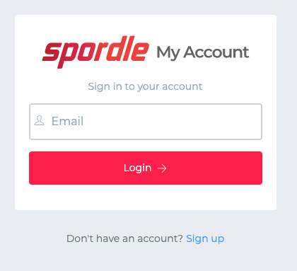
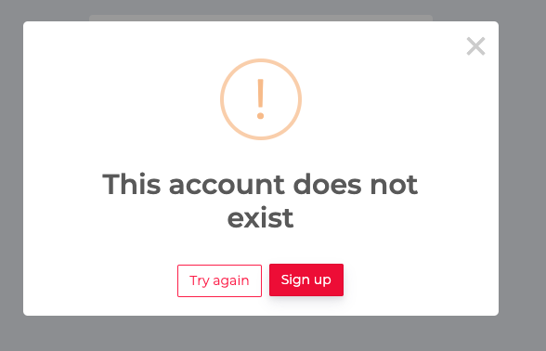
First Sign-in
You can either enter your email you have used before, or click on the “Sign up” as they both will end up doing the same thing in the end.
You may get the error message of the email does not exist. This is OK, just continue to click on Sign up.
WMHA July 1, 2021

Slide 5
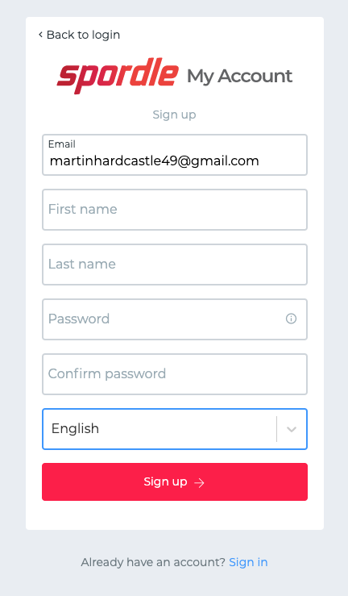
Making Your Account
Fill out the form that appears to enter your email, first name and last name.
NOTE: ensure the email is valid as well as you are able to access that email as a verification code is sent in the next step!
The password you create must have the following as a minimum:
- 8 characters
- 1 Upper case letter
- 1 lower case letter
- 1 number
- 1 special character (e.g. *^_?, etc)
Once entered, click “Sign up”
email address
WMHA July 1, 2021

Slide 6
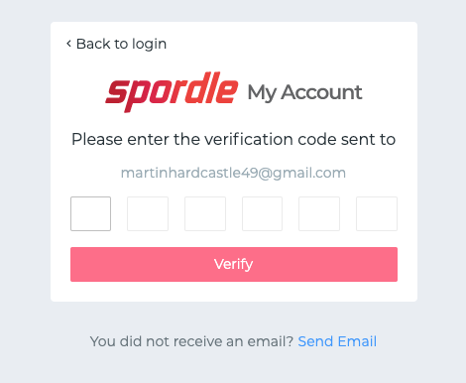
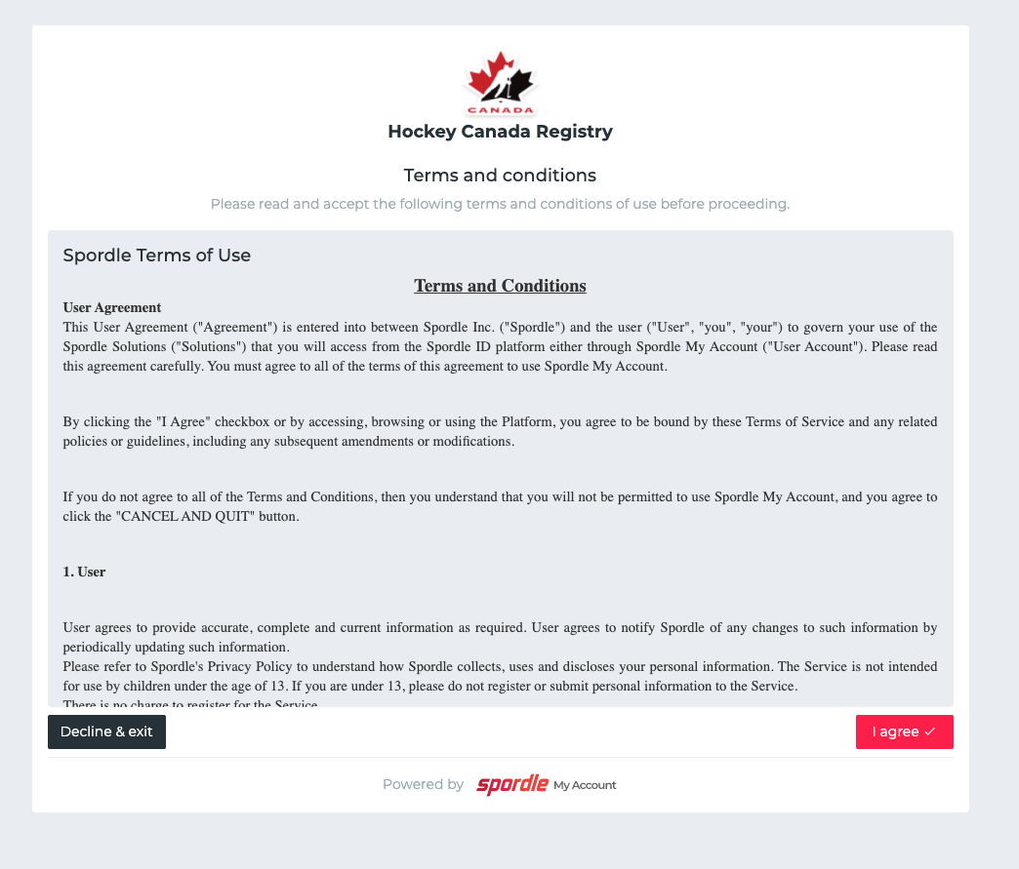
Making Your Account
Enter the verification code sent to you via email. If Email is not received, you can try the “Send Email” link on the bottom. As well, ensure to check your spam/junk folders as well if you feel you have not got the email.
Once entered, click “Verify”
If verification is valid, you will be directed to the login screen again.
Login (again), and then agree to Hockey Canada Registry Terms and Conditions.
After that, you will be directed to the Register Now! page again, but this time you are signed in and ready to register participants.
WMHA July 1, 2021

Slide 7
Registering
To register a player, you need to start by clicking on “View Online Stores”. NOTE: The examples used in the following slides were done by Halton Hills Minor Hockey.
WMHA July 1, 2021

Slide 8
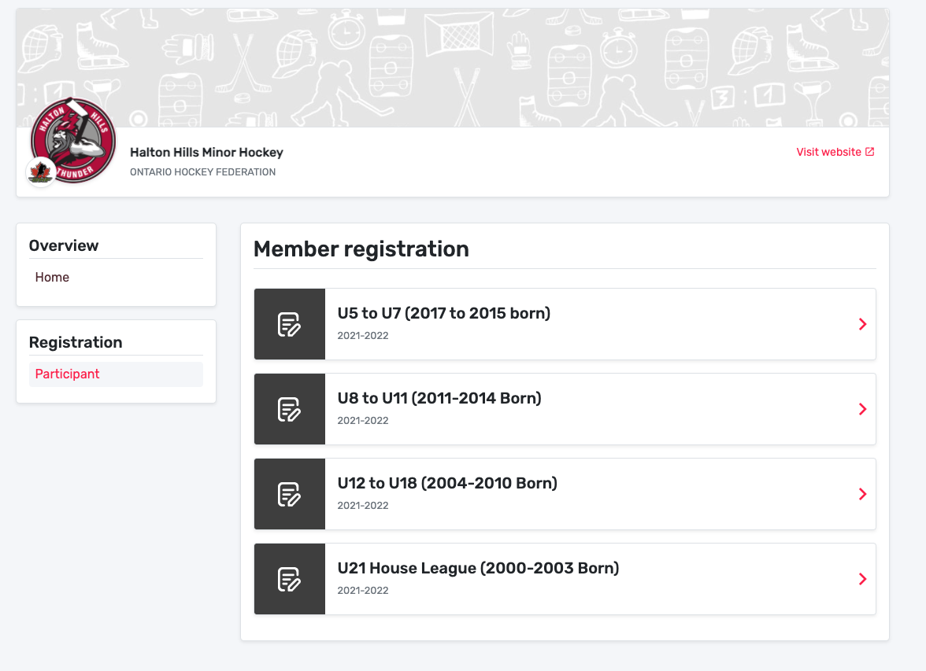
Registering
Online Store
Simply choose an online store which matches the birth year range for your player.
WMHA July 1, 2021

Slide 9
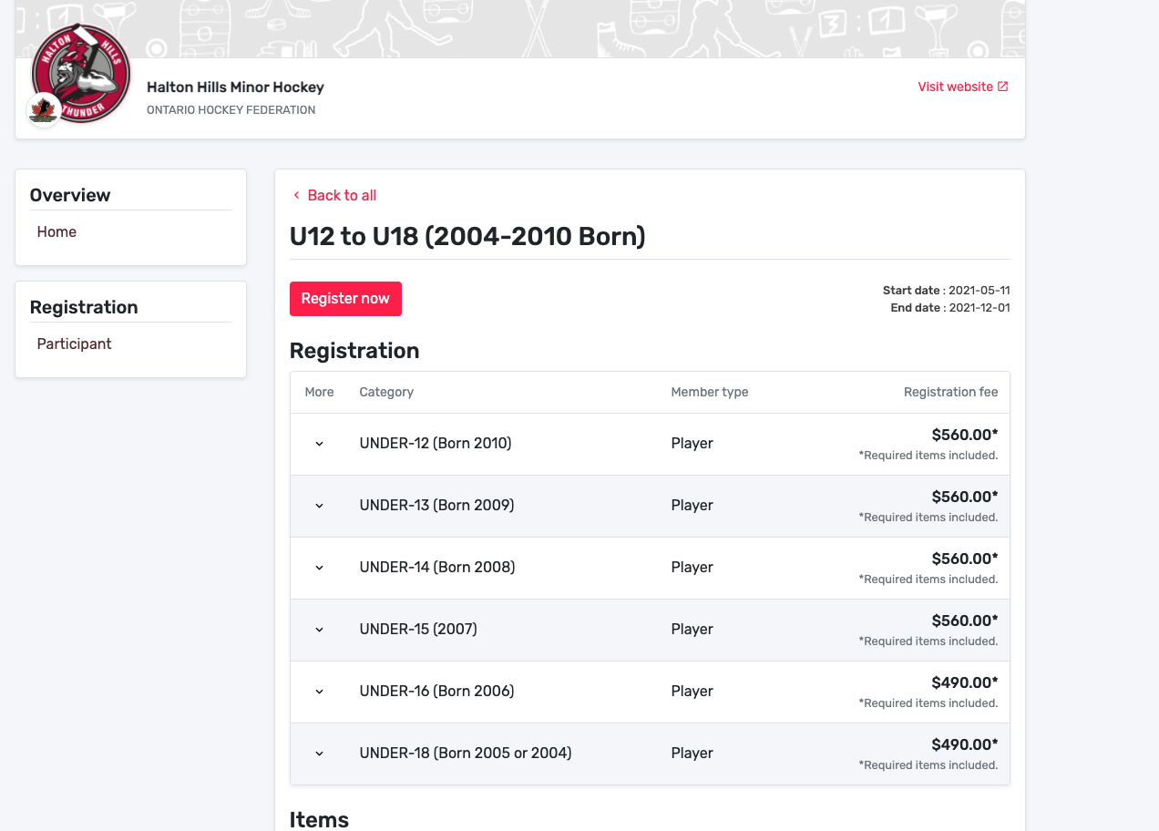
Registering
Online Store
Once one is selected it will open up to show you the fees and associated.
NOTE: On top of Basic Registration, the Admin fee is the only other mandatory fee. Tryout Cards are optional unless you plan on trying out.
Click “Register Now” in the online store. ****prices shown are not accurate***
WMHA July 1, 2021

Slide 10
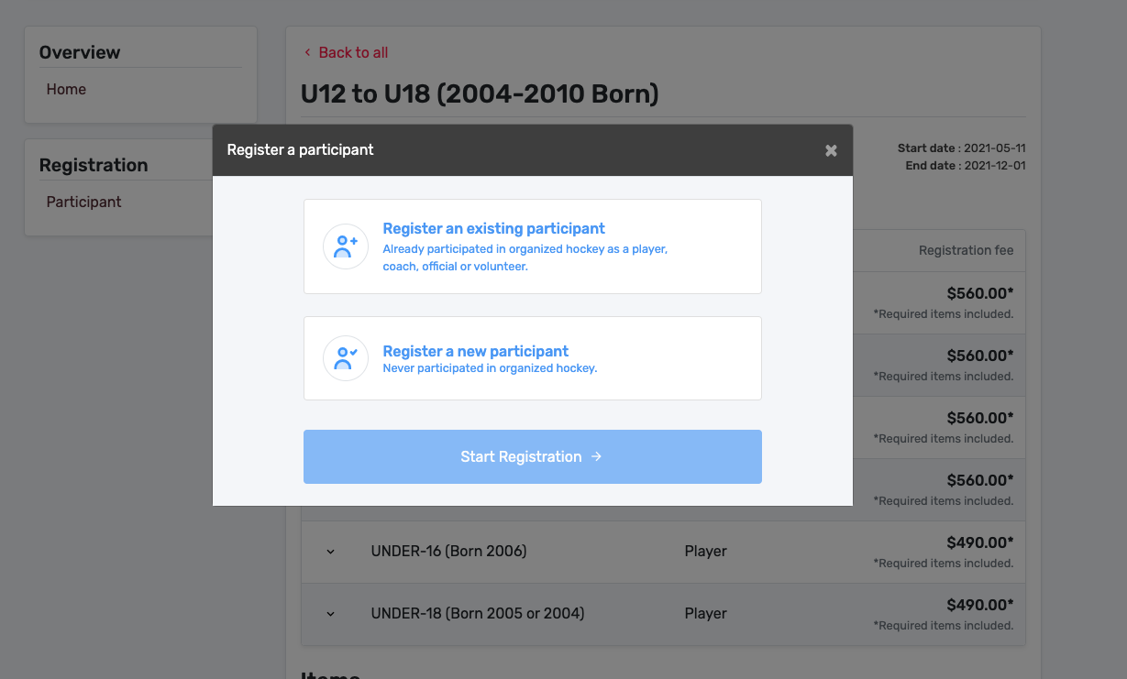
Registering
You have the option of Registering an existing participant OR to register a new participant.
Simply put, if your participant has played before, you can use existing, if not you use register a new participant.
Once your selection is made, click “Start Registration”
Let’s start with existing participant… ****prices shown are not accurate***
WMHA July 1, 2021

Slide 11
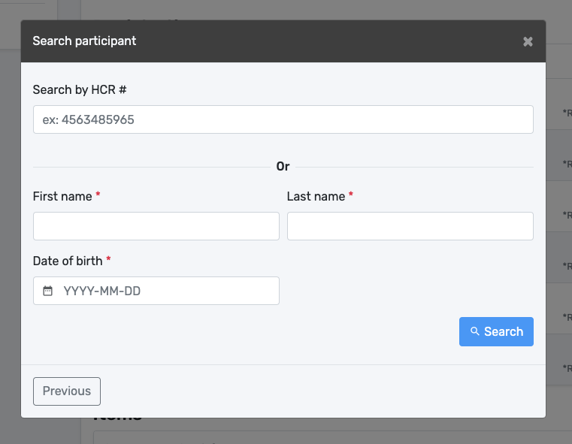
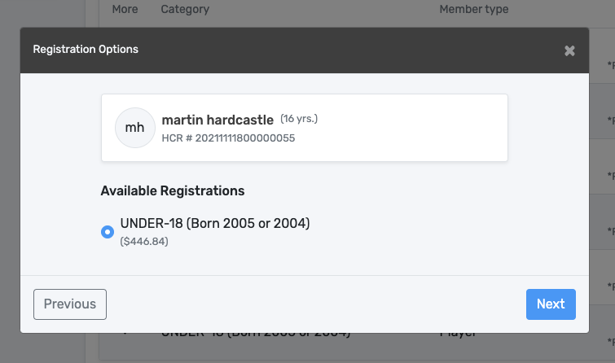
Registering
EXISTING PARTICIPANT
They may show up in your account, but if not, you simply have to search for them and then select.
You can search by HCR# or by First, Last name
AND Birthdate (required).
Once found a list of available registrations is displayed under their name, but BE CAREFUL as there may be multiple selections. The default selection should be the correct one based on the birth year, however, READ and CONFIRM carefully!
WMHA July 1, 2021

Slide 12
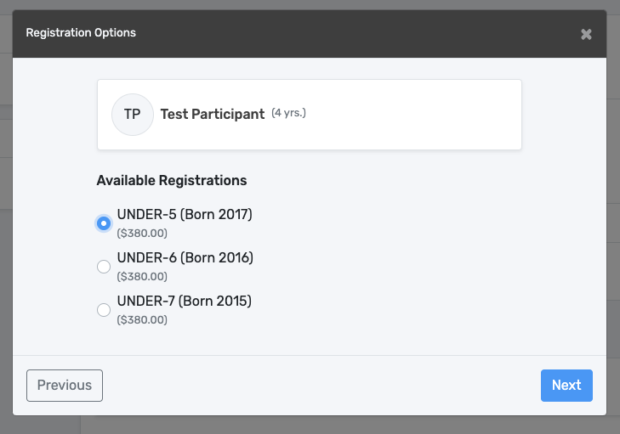
Registering
EXISTING PARTICIPANT
Again, the default selection should be the correct one based on the birth year, however, READ and CONFIRM carefully!
The example on the right, shows an example of multiple selections. DO NOT USE the age of the participant in brackets. Pick the proper available registration based on BIRTH YEAR!
Then click “Next”
Pick the applicable registration, by reference to birth year!
WMHA July 1, 2021

Slide 13
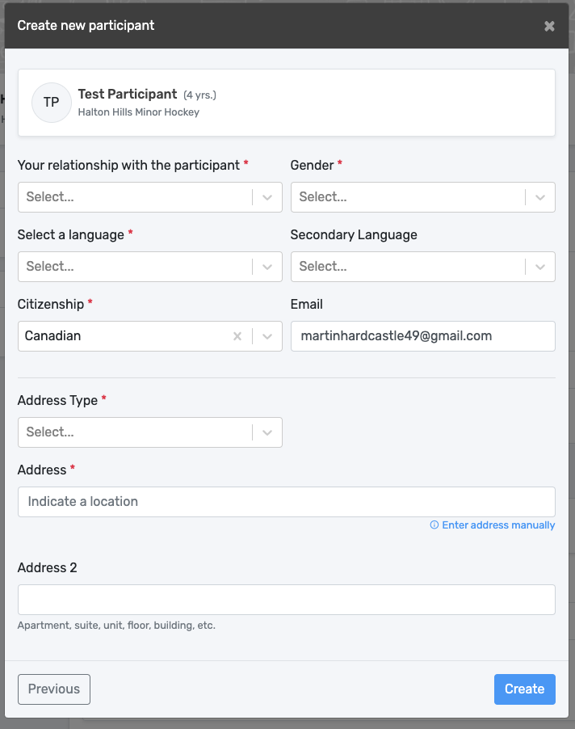
Registering
NEW PARTICIPANT
The process for a new participant is the same as explained previously, except BEFORE you get to available registrations you will be filling out all the information for the new participant, including all your information, address etc.
Remember to only select NEW Participant if they have never played hockey before with Hockey Canada.
WMHA July 1, 2021

Slide 14
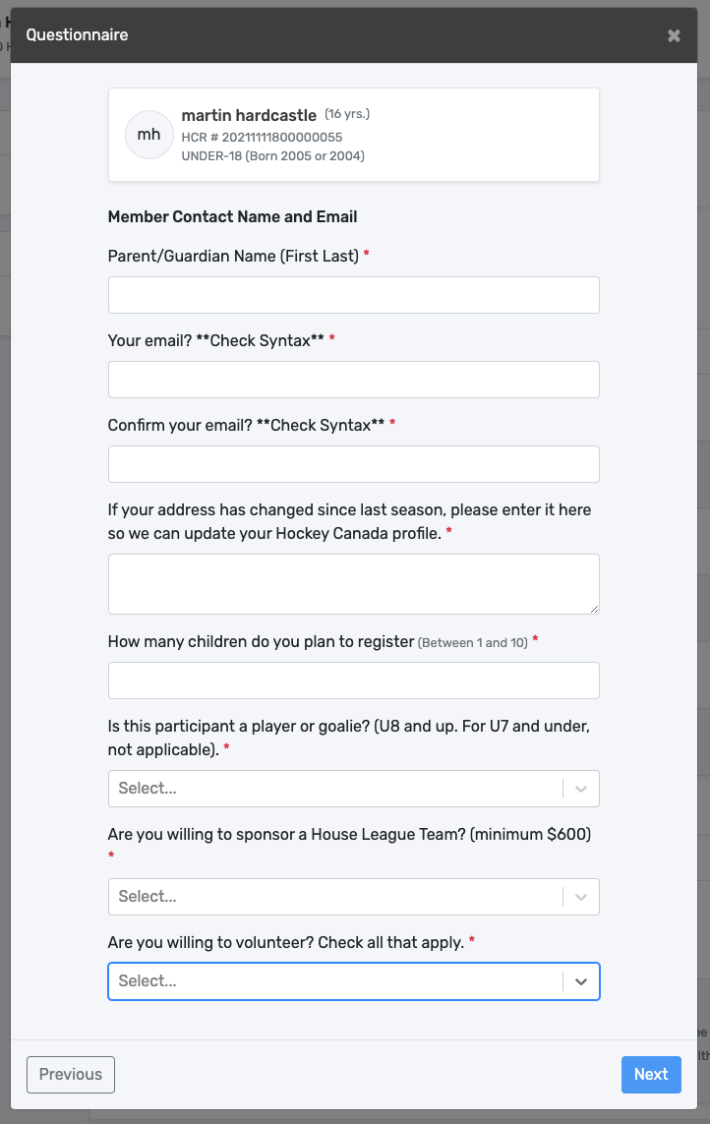
Registering
Questionnaire
Once the participant is selected and their applicable category, the next step is a questionnaire. If you have multiple player families, you will unfortunately have to fill this out again for each player. We apologize for this, however, it is simply a result of “how the system works”.
As we are a part of the pilot project, we are giving feedback on what we find and hope in the future, this is something that can be more targeted. (i.e. one questionnaire per family). Having said that, if you have multiple players to register, after the first questionnaire simply put in “ND” in required boxes to indicate that it is a repeat if you wish.
One note on the email address, this does not have to be the same email you used for HCR. It can be any email that you wish to be used to be contacted for timely and required information that we cannot have missed by not visiting the website. We promise to send out emails ONLY when we have to. Otherwise all other information can be found on the website.
WMHA July 1, 2021

Slide 15
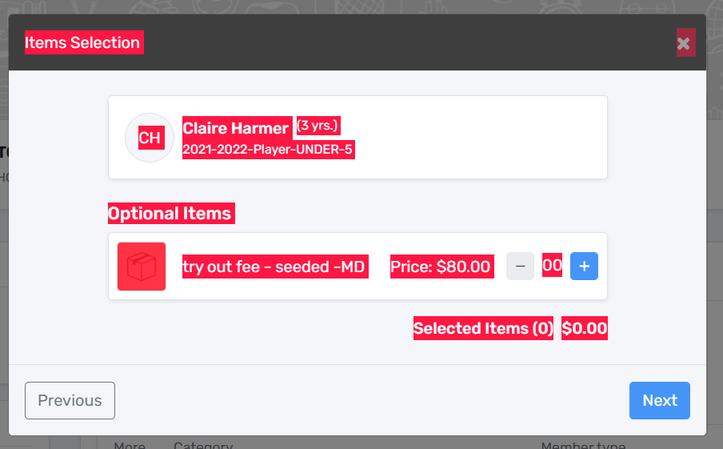
Registering
Mandatory Items/Optional Items
Once you have clicked “Next” on the questionnaire you will be brought to the additional items (above basic registration) that you will click.
The tryout card is available for fall tryouts. The description of the fee on HCR is self explanatory as well as info can be found on our website. You must select the “+” to add a tryout card to your cart. If you do not wish to purchase a tryout card, simply leave it at zero.
Click Next ****prices shown are not accurate***
The $5.00 admin fee is mandatory and cannot be reduced to zero. As well, do not click the “+” sign or it will add another $5.00.
WMHA July 1, 2021

Slide 16
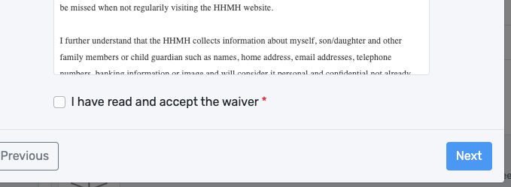
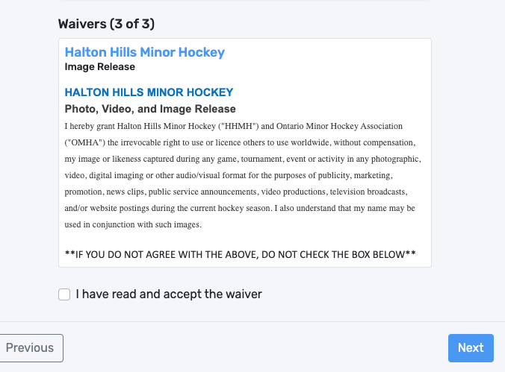
Registering
Waivers
Next are the waivers. This will include both Hockey Canada waivers and waivers by WMHA. WMHA has 3 waivers this year. The first two are mandatory to play and the last waiver is based on image release.
If you are registering multiple participants, you may only have to fill out the WMHA waivers for the remaining participants.
For the image release, read carefully, DO NOT check the box if you do not agree.
WMHA July 1, 2021

Slide 17
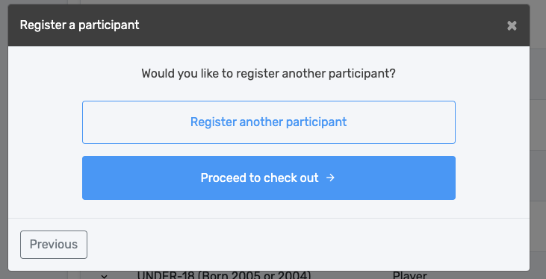
Registering
Checking Out? Registering another player?
Once you have clicked on the last waiver you are brought here. It asks if you want to proceed to checkout or if you want to register another. If you accidentally press the wrong selection, you will get another chance to go to payment or register another participant depending on what you selected.
ONE HICCUP TO “REGISTER ANOTHER PLAYER”
If you are going to register another player, the player’s age MUST fall into the same category/store. For example, if you are registering two or more participants in the U12-U18 store, you can register another player. HOWEVER, IF the next participant is in a different ‘store’ (e.g. U8-U11) you must proceed to checkout and then start again. The feature to select a different store and may be available in the future, however, right now, you must select proceed to checkout if they are two different age brackets/stores. This of course will generate separate receipts for each time you checkout.
WMHA July 1, 2021

Slide 18
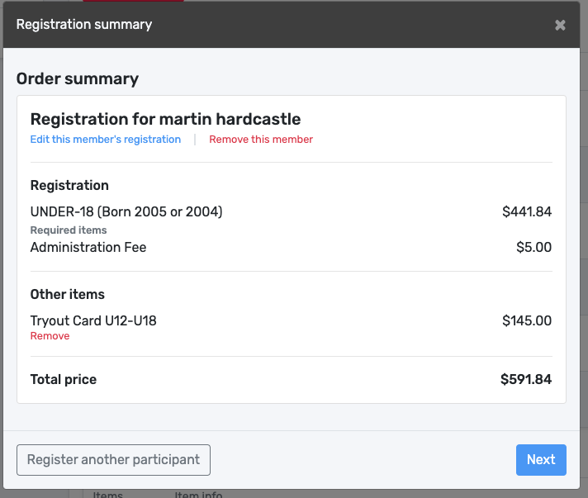
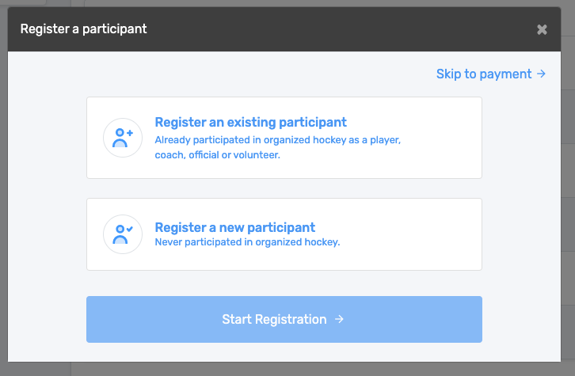
Registering
Made a Mistake/Forgot Something? No Problem
Review your “order”. If something isn’t correct you can:
1. Remove optional items (i.e. Tryout Card) or
2. Edit the registration whereby it will take you back to the start of that member and you can redo it. (e.g. selected wrong birth year, forgot to add the tryout card, etc)
WMHA July 1, 2021

Slide 19
Registering
Your Cart/checkout
Prior to checkout you get the Order summary. If you wanted to register another, you can see the button the bottom left. Otherwise, if you are OK with the summary simply click next.
If you accidentally selected Register another participant and wanted to check out, you can get back to your checkout by selecting Skip to payment.
NOTE: Fees shown are not correct. For example purposes only.
WMHA July 1, 2021

Slide 20
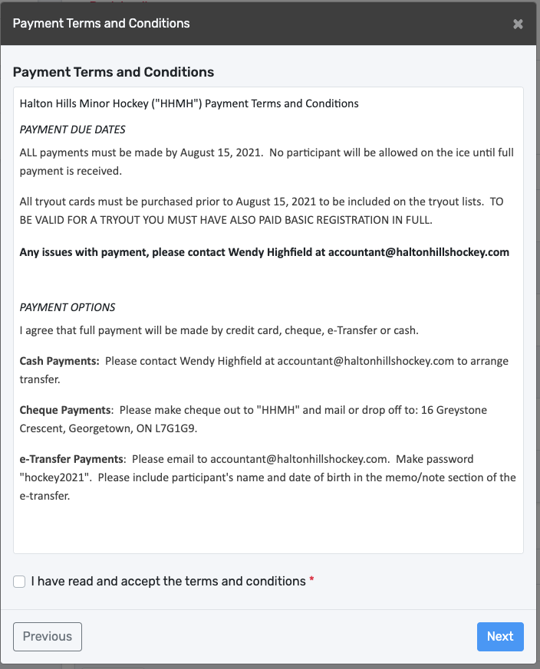
Registering
Terms and Conditions
Next is our terms and conditions of payment. Payment will be available by Credit Card, Cash or e-Transfer. You must accept the Terms and Conditions.
**IMPORTANT!**
Instructions on e-Transfer and other forms of payment are provided here. Please read it carefully.
*PASSWORD HIDDEN for graphic
WMHA July 1, 2021

Slide 21
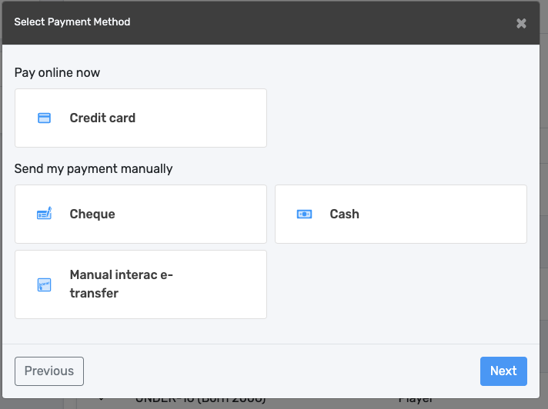
Registering
Payment
Payment options are:
Credit Card
Cash
e-Transfer
Credit Card is instantly paid online like any other online transaction, simply follow the directions. All other payments require delivery as per the Terms and Conditions you see during payment. Please read Terms and Conditions carefully when they come up and you accept them.
Select the applicable payment method.
NOTE: Instructions on e-Transfer are in Terms and Conditions. Please read it carefully.
WMHA July 1, 2021

Slide 22
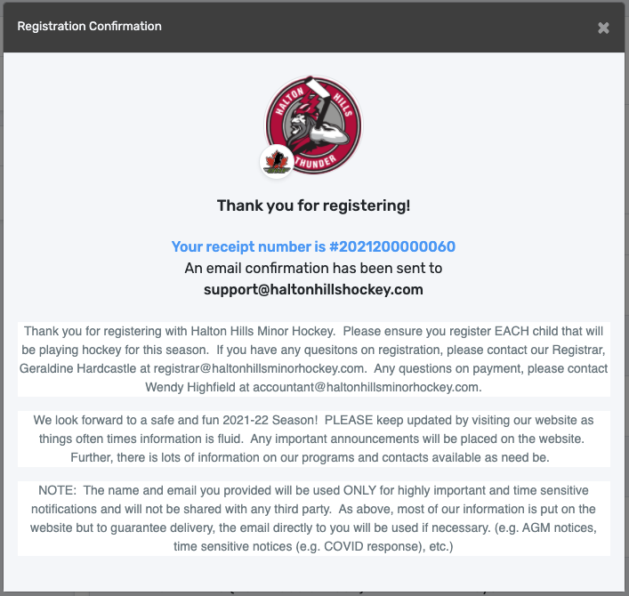
Oops, I forgot something!
This would apply if you wanted to purchase a tryout card and did not select it or if your player “changed their mind” and decided they did want to tryout or not tryout.
If this happens, please contact Pat Langdon wmha@bellnet.ca
At this time, there is no way to go back into the “stores” to purchase Other Items at this time. It has to be manually done in the background.
WMHA July 1, 2021

Slide 23
You are done!
When you see this screen, congratulations, you have successfully registered a player. The email confirmation you receive is simply an invoice showing the all items purchased.
WMHA July 1, 2021

Slide 24
Questions?
ISSUES?
If you get stuck or have issues or notice a ‘glitch’.
Please email wmha@bellnet.ca and provide:
1. your name
2. phone number
3. Name of who you are trying to register and their birth year
4. brief description of the issue.
Thanks.
WMHA July 1, 2021

